Slide 1
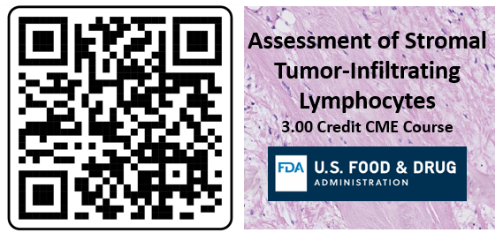
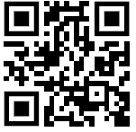

Assessment of Stromal Tumor-Infiltrating Lymphocytes 3.00 CME Credits
3.00 CME Credit Course
4 Part Course:
Clinical context of stromal tumor-infiltrating lymphocytes (sTILs)
Video on steps of the sTILs Assessment
Pitfalls in the sTILs Assessment
Manuscript on sTILs evaluation
(Salgado et al., Ann Oncol. 2015)
Create an account: https://ceportal.fda.gov/
Click on “Online Learning” tab
Scroll to “Assessment of Stromal Tumor-Infiltrating Lymphocytes”

Slide 2
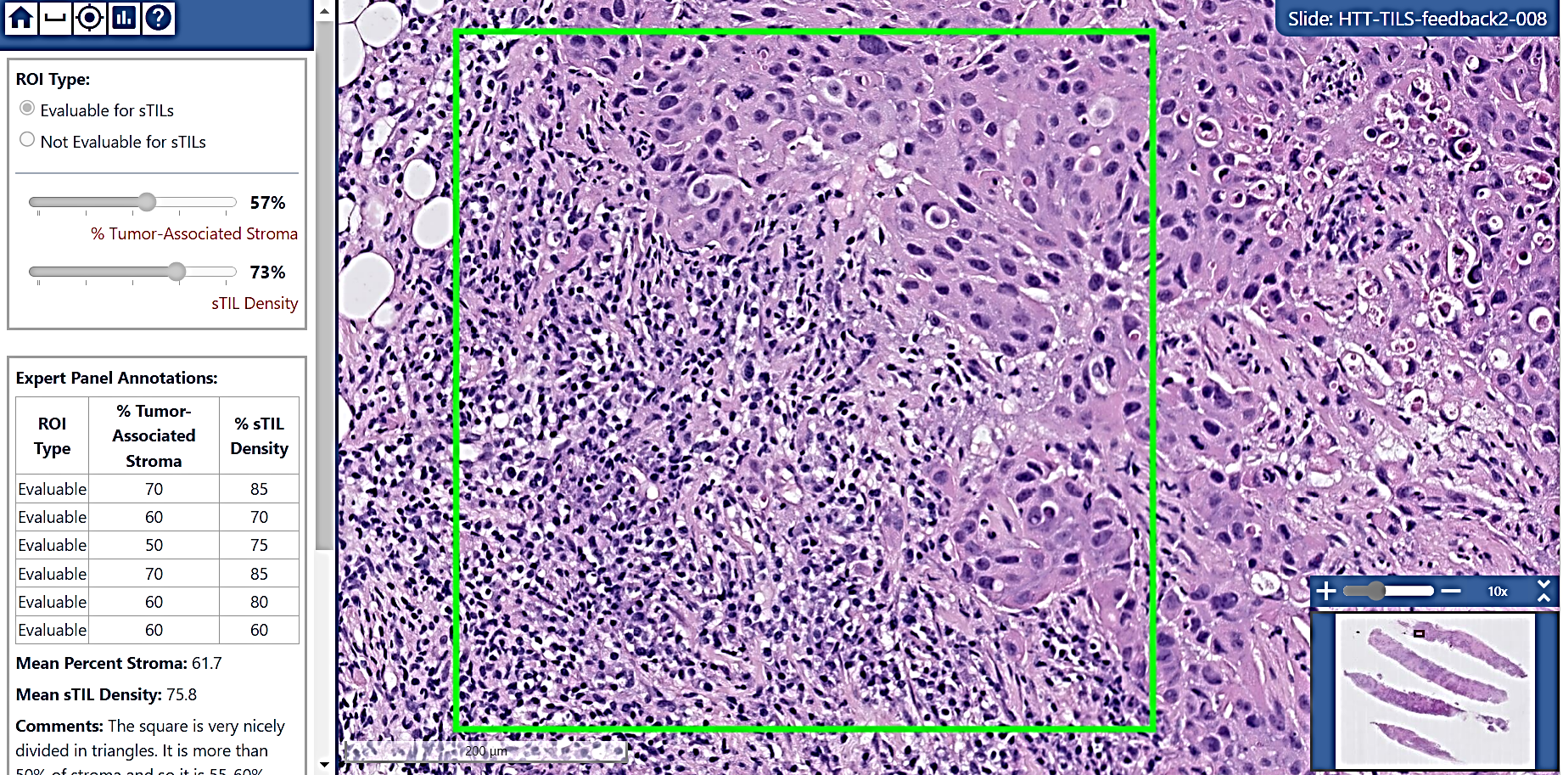
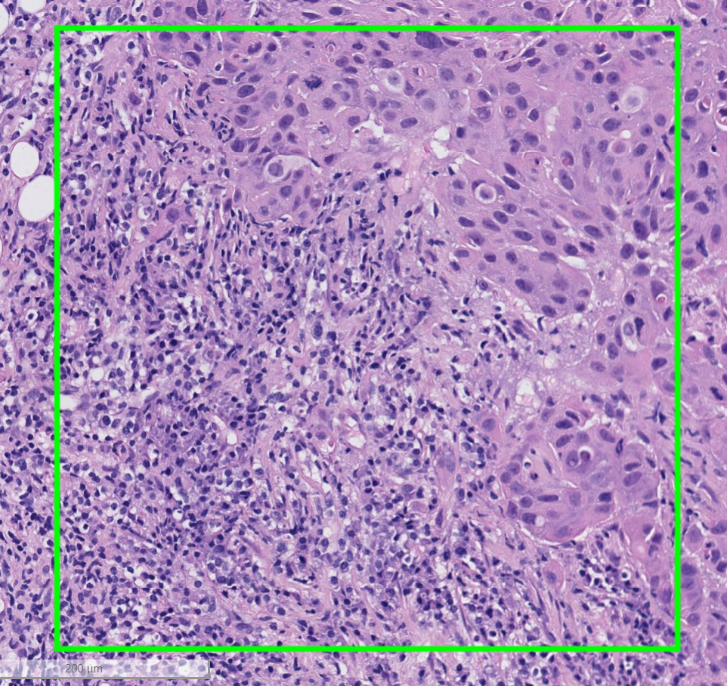
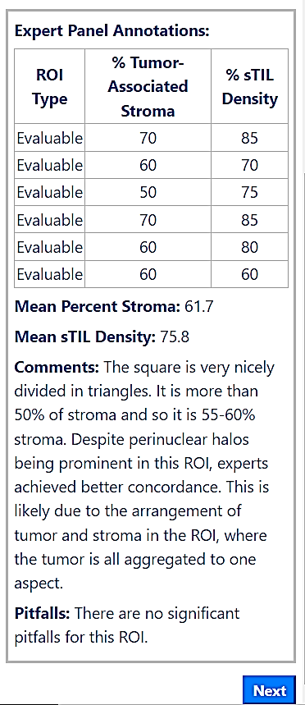
Interactive Training for Annotators
The Annotation Task
A
B
C
D
Expert Feedback: Mean Percent Stroma: 61.7 Mean sTIL Density: 75.8
Comments: The square is very nicely divided in triangles. It is more than 50% of stroma and so it is 55-60% stroma. Despite perinuclear halos being prominent in this ROI, experts achieved better than average concordance compared to other similar ROIs. This concordance is likely due to the arrangement of tumor and stroma in the ROI, where the tumor is all aggregated to one aspect.
Pitfalls: There are no significant pitfalls for this ROI.
Annotation Fields
Region of Interest
Figure 2. Example of interactive training module for sTILs Assessment: Test with Feedback. This module allows pathologists to make an annotation of a displayed ROI’s evaluability for sTILs assessment, percent tumor-associated stroma, and sTILs density. Upon saving the annotation, the pathologist can compare their score against that of six experts and review comments and pitfalls as described by the experts [4].
Interactive Training Gives You Feedback!
After annotating an ROI the Feedback Test provides scores, comments and pitfalls from a panel of experts

Slide 3
The Annotation Task
3.00 CME Credit Course
Annotation Fields
Region of Interest
Create an account: https://ceportal.fda.gov/
Click on “Online Learning” tab
Scroll to “Assessment of Stromal Tumor-Infiltrating Lymphocytes”
Interactive Training Gives You Feedback!
After annotating an ROI the Feedback Test provides scores, comments and pitfalls from a panel of experts

Slide 4
Version 2

Slide 5

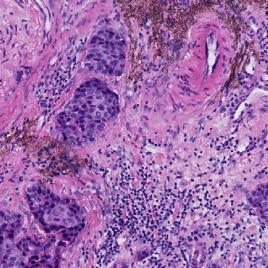
https://didsr.github.io/HTT.home/assets/pages/pivotal-study/pdfs-images/recruitReadersFlyer-2023.pdf

Slide 6
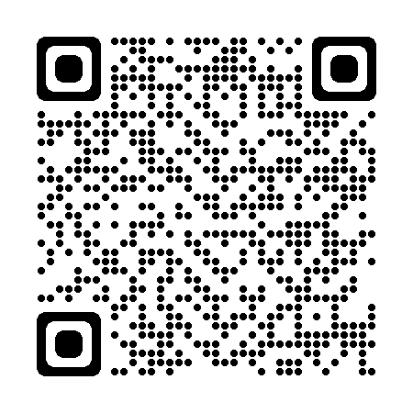
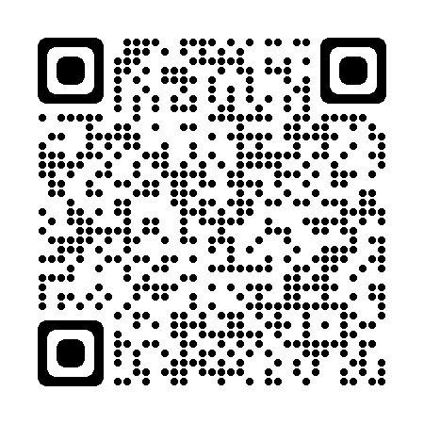
Learn More About the
HTT Project!
3.00 CME Credit Course
Create an account: https://ceportal.fda.gov/
Click on “Online Learning” tab
Scroll to “Assessment of Stromal Tumor-Infiltrating Lymphocytes”
Or visit: https://didsr.github.io/HTT.home/
Background, Goals, Context, Methods
Publications and Accomplishments
Technologies and Training
Get Involved!

Slide 7
The Annotation Task
Interactive Training
Gives You Feedback!
After annotating an ROI the Feedback Test provides scores, comments and pitfalls from a panel of experts
Annotation Fields
Region of Interest

